Slide 1
CAPM DAY 1 - INTRODUCTION TO SAP CLOUD PLATFORM

Slide 2

What is SAP Cloud Platform?
Platform as a service(PaaS).
Innovative cloud deployment and development platform
Build, extend and integrate business applications in the cloud.
Supported by multiple cloud infrastructure providers like AWS, GCP, Azure, Alibaba Cloud and SAP as well.

Slide 3
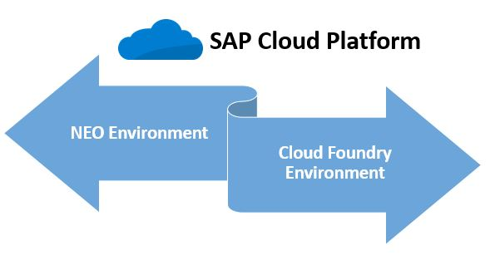
Environments in SAP Cloud Platform
Cloud Foundry Environment
Neo Environment

Slide 4
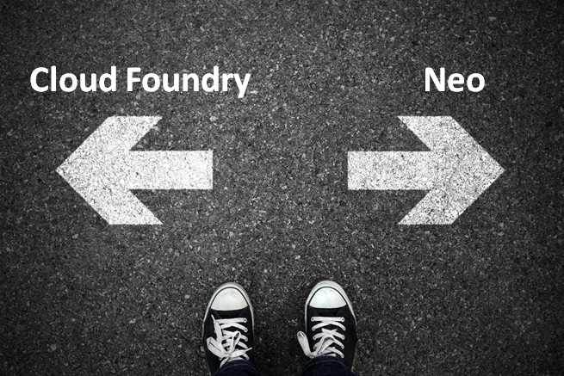
Which environment to use?

Slide 5
Cloud Foundry Environment
Environments
Open source platform maintained by Cloud Foundry environment.
Multiple run times like Java, Node.js.
We can bring in our own languages.
IoT, Machine learning scenarios and develop applications using SAP HANA extended application services advanced model.
Multiple data centers like GCP, Azure and AWS.

Slide 6
Neo Environment
Environments
SAP Cloud Platform Neo environment contains SAP propriety runtime
Supports a fixed set of runtimes and programming languages like Java, HTML5 and SAP HANA XS Applications.
You can use the UI Development Toolkit for HTML5(SAPUI5) to develop rich user interfaces for modern web-based business applications.
Runs in SAP data centers.

Slide 7
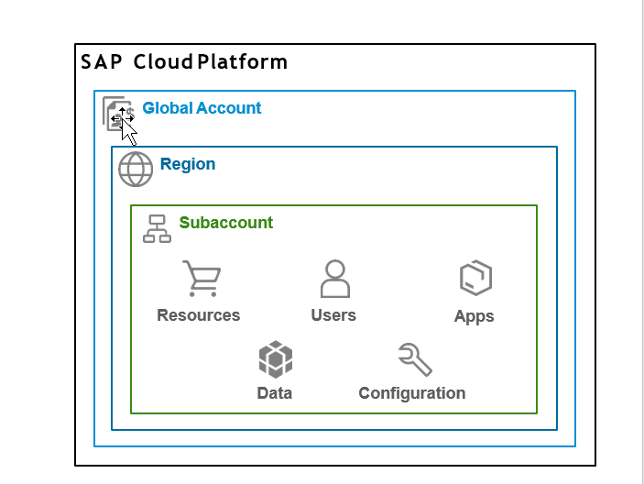
SAP Cloud Platform Accounts
Global accounts and sub accounts in SAP Cloud Platform are the way in which all of your activities in SAP Cloud Platform are structured.

Slide 8
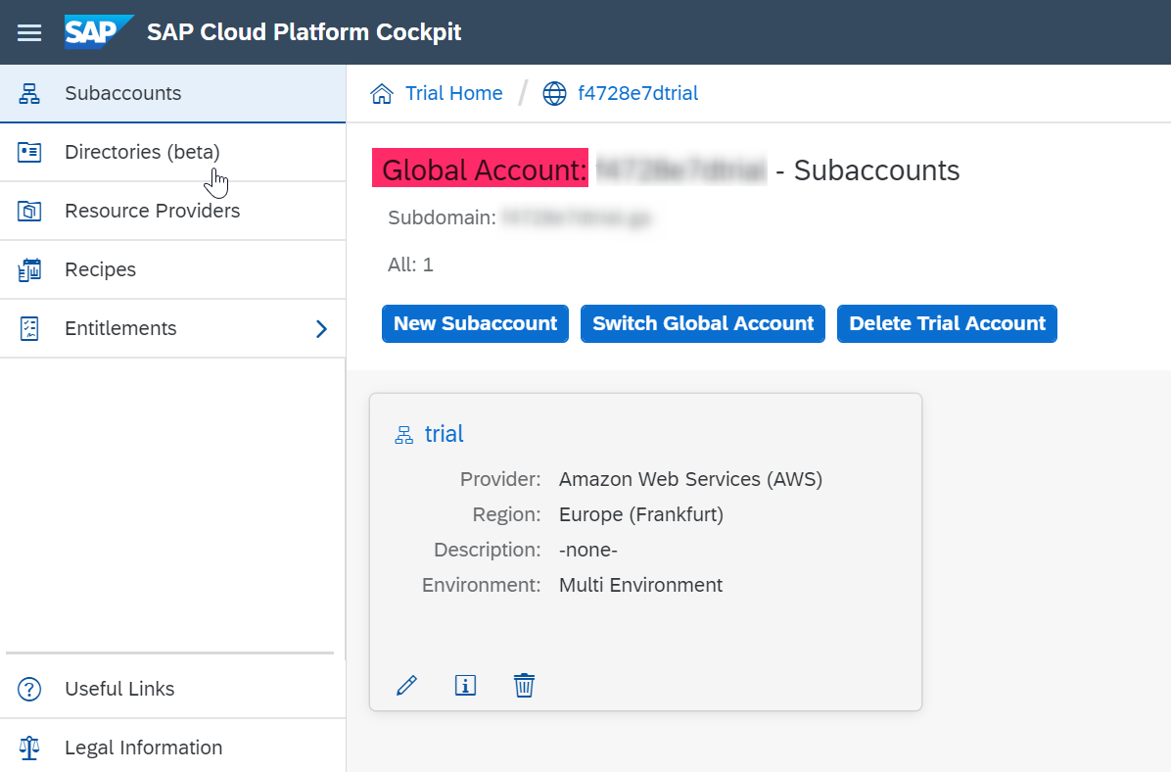
Global Account
SAP Cloud Platform Accounts
Realization of contract made with SAP.
Region and environment independent.
Two type of Global Accounts
Enterprise Account (paid)
Trial Account (free)
All metrics, billing, quota and resources done for a Global Account.

Slide 9
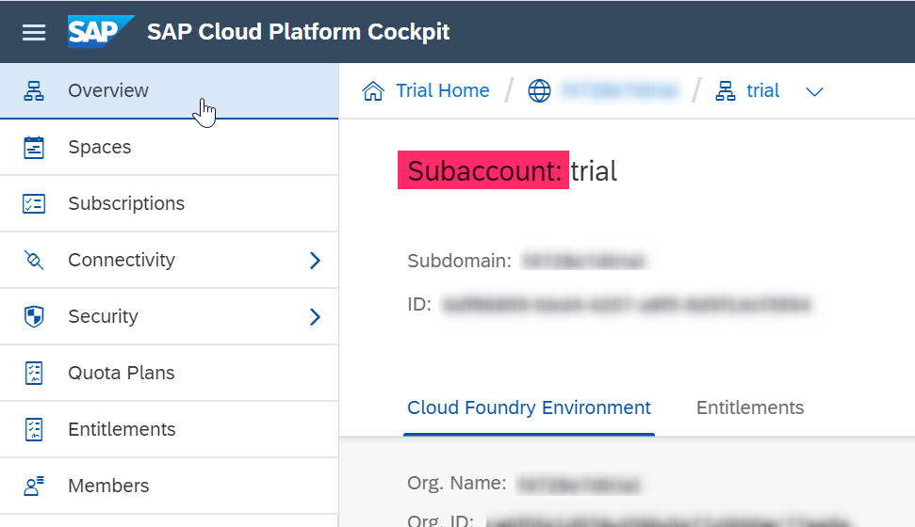
Subaccount
SAP Cloud Platform Accounts
A Global Account can host multiple Sub Accounts.
Subaccounts in a Global Account are independent of each other.
Each subaccount is associated with a region and independent of our own location.
Spaces can be configured inside a subaccount for different business needs, or development teams according to the use cases.
The entitlements and quotas that have been purchased for a Global account have to be assigned to the individual sub accounts.

Slide 10
Regions
SAP Cloud Platform Accounts
Represents a geographical location where applications, data and services are hosted.
A region is associated with one data center.
Provided by SAP or by Infrastructure-as-a-Service(IaaS) partners like Amazon Web Services (AWS), Microsoft Azure, Alibaba Cloud and Google Cloud Platform (GCP).
Region is chosen at the subaccount level.
For each subaccount we choose exactly one region and one environment.
For each region there is a different API Endpoint.
api.cf.us20.hana.ondemand.com – US West
api.cf.eu10.hana.ondemand.com – Europe (Frankfurt)

Slide 11
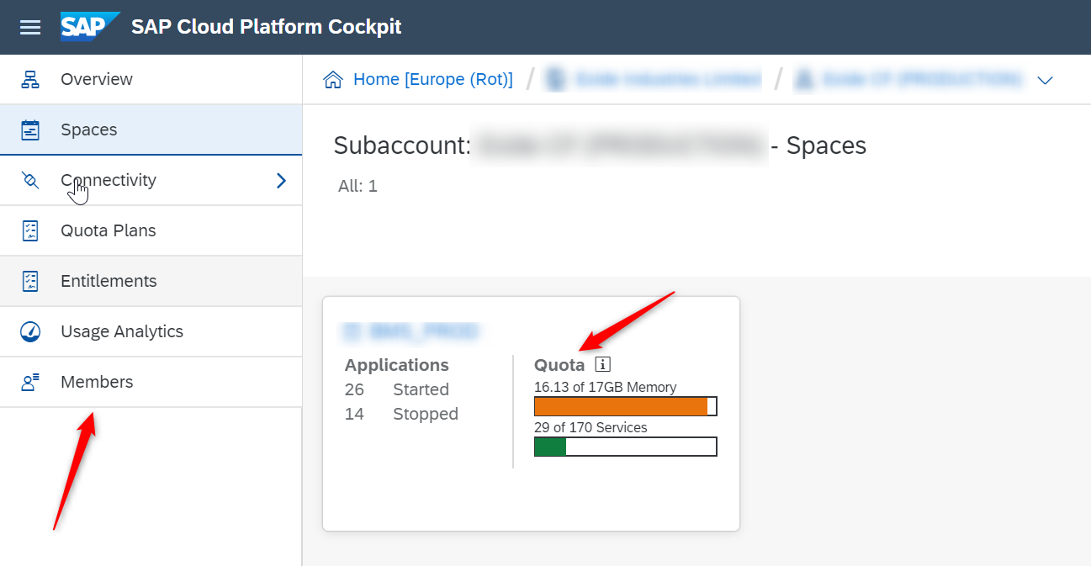
Spaces
SAP Cloud Platform Accounts
Cloud Foundry has a standard working environment for individual applications called spaces.
Spaces are individual working areas, which can contain more than one application.
Each space has an allocation of resources from the global account (the global account belongs to your team or organization).
The allocation is called a quota by SAP, and limits the amount of memory, the number of URL’s (called routes), and other resources.
Each space is assigned to 1 or more users (called members).

Slide 12
Entitlements
SAP Cloud Platform Accounts
On SAP Cloud Platform, all external dependencies such as databases, messaging systems, files systems, and so on, are services.
Each service has one or more service plans available. A service plan is the representation of the costs and benefits for a given variant of a particular service.
An entitlement is your right to provision and consume a resource.
In other words, entitlements are what service plans you're entitled to use.

Slide 13
Quotas
SAP Cloud Platform Accounts
Represents a numeric quantity that defines the maximum allowed consumptions of a resource.
Some use numeric quota
Depending on the service, they may represent different things.
Some show as ‘limited’.
Entitle that service to multiple subaccounts without having to worry about how much of it to distribute to each subaccount.

Slide 14
Trial Accounts
SAP Cloud Platform Accounts
Free of charge with limited services and functionality.
One trial account per user.
Expires after 30 days, but can be extended to a limit of 90 days.
No service – level agreement with regard to availability of the platform.
Applications stop automatically after a certain period of time.

Slide 15
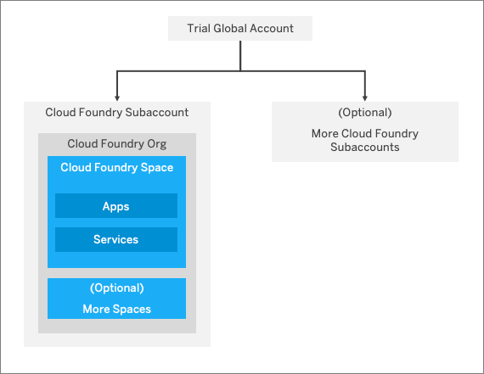
SAP Cloud Platform Accounts
Trial Account Structure

Slide 16
SAP Cloud Platform Cockpit
SAP Cloud Platform cockpit is the consolidated destination for operational needs.
Entry point to SAP Cloud Platform on the web.
Monitoring of resources, databases and applications.
Entire administration can be done from SAP Cloud Platform cockpit.

Slide 17
Navigation in the cockpit
SAP Cloud Platform Cockpit
There are 2 ways of navigating inside the cockpit
Using the left-hand side navigation
Using the path at the top of the page.
There are certain actions you can perform at each hierarchical level (global account, sub accounts, spaces etc.) called scope.
Inside the global account we can add members, create more subaccounts, add entitlements and quotas to subaccounts. These actions come under the global account scope.

Slide 18
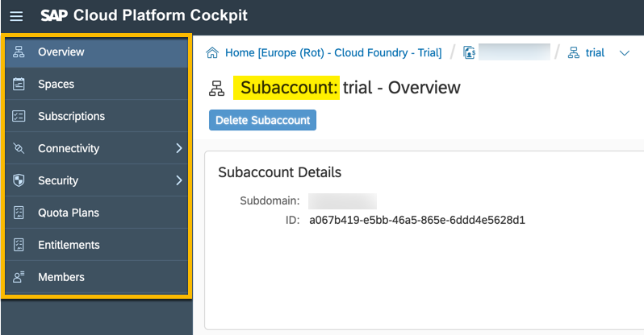
Left hand–side navigation
SAP Cloud Platform Cockpit
Cloud Foundry Subaccount scope:

Slide 19
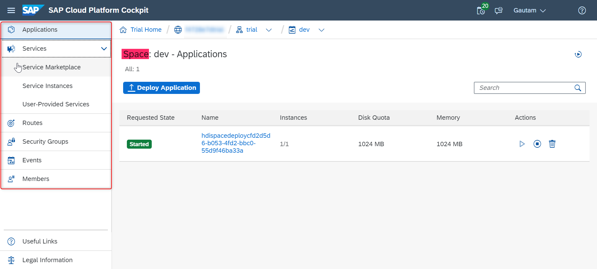
Cloud Foundry Space Scope:
SAP Cloud Platform Cockpit

Slide 20
Breadcrumbs
SAP Cloud Platform Cockpit
You can navigate back using the breadcrumbs at the top.
Indicate the hierarchical path you have travelled in order to reach your current scope in the cockpit.
The last item in the breadcrumbs always represents the scope you find yourself in at the moment
To go back follow the breadcrumbs to retrace your steps.

Slide 21
Breadcrumbs
SAP Cloud Platform Cockpit
Trial Home : - trial homepage
Global account – All your subaccounts and entitlements.
Represents your subaccount
Represents your space.
Your application running inside the space. Your current scope.

Slide 22
Services in the Cloud Foundry Environment
Create service instances and bind them to applications within that space.
A single instantiation of service running on SAP Cloud Platform.
Created using a specific service plan.
A service plan is a configuration variant of a service.
To integrate services with applications, the service credentials must be delivered to the application.
Bind service instances to your application to automatically deliver these credentials.

Slide 23
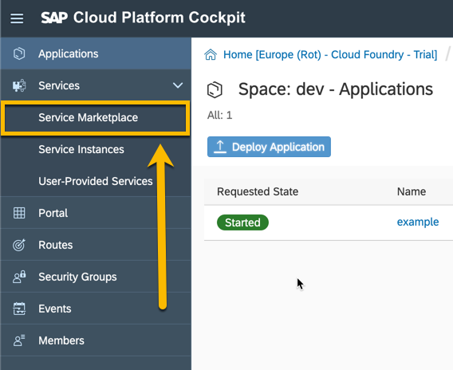
To create a service instance
Services in the Cloud Foundry Environment
Navigate to your space in the Cloud Foundry environment where you want to create the instance and choose Service Marketplace from the left hand-side navigation.

Slide 24
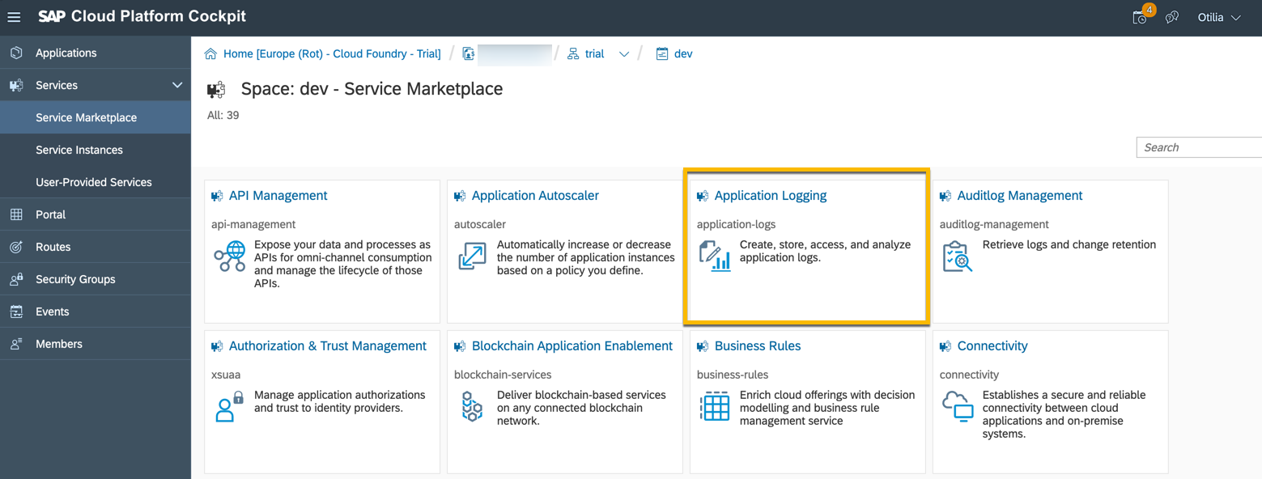
2. Choose the service for which you want to create an instance (let’s choose Application Logging as an example).
Services in the Cloud Foundry Environment
To create a service instance

Slide 25
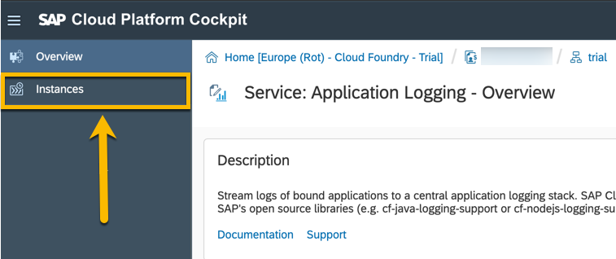
3. In the left hand side navigation choose instances.
Services in the Cloud Foundry Environment
To create a service instance

Slide 26
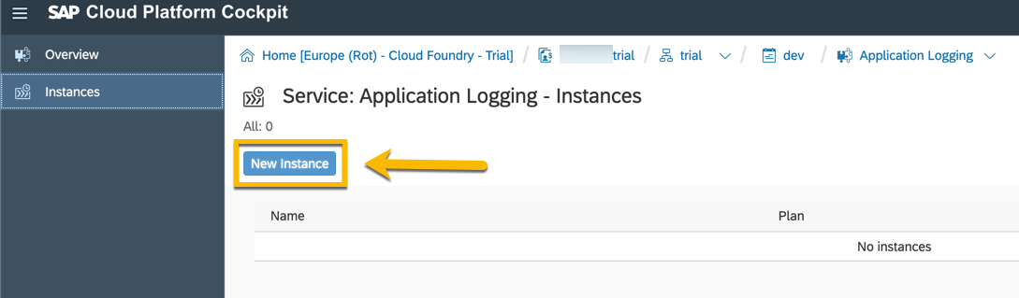
4. Click on the new instance button
Services in the Cloud Foundry Environment
To create a service instance

Slide 27
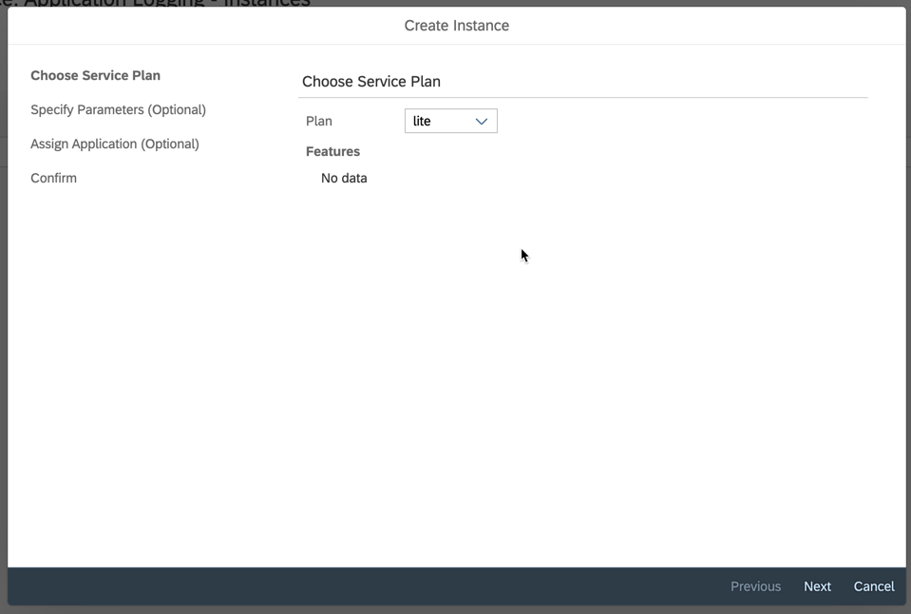
Follow the wizard to finalize the creation of the instance. This includes choosing a service plan and optionally adding parameters and an application to bind the instance to.
Services in the Cloud Foundry Environment
To create a service instance

Slide 28
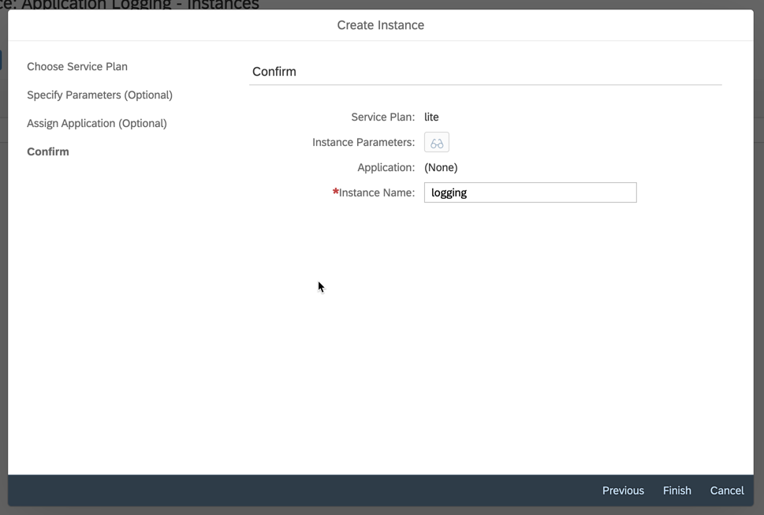
Finally enter a name for your instance and choose finish
Services in the Cloud Foundry Environment
To create a service instance

Slide 29
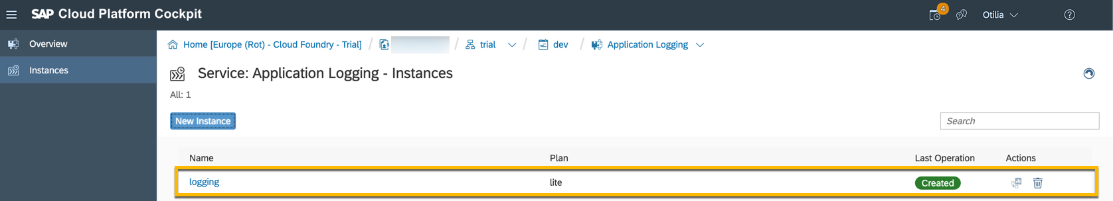
Your new instance will appear as shown below.
Services in the Cloud Foundry Environment
To create a service instance

Slide 30
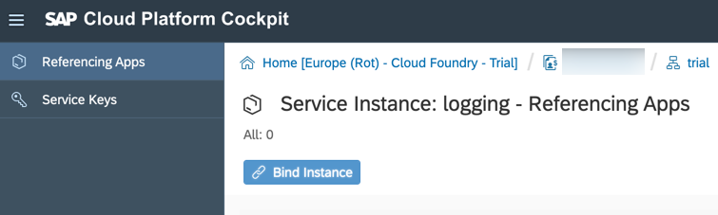
Services in the Cloud Foundry Environment
To create a service instance
You can then click on it to bind it to an application if not done already.

Slide 31
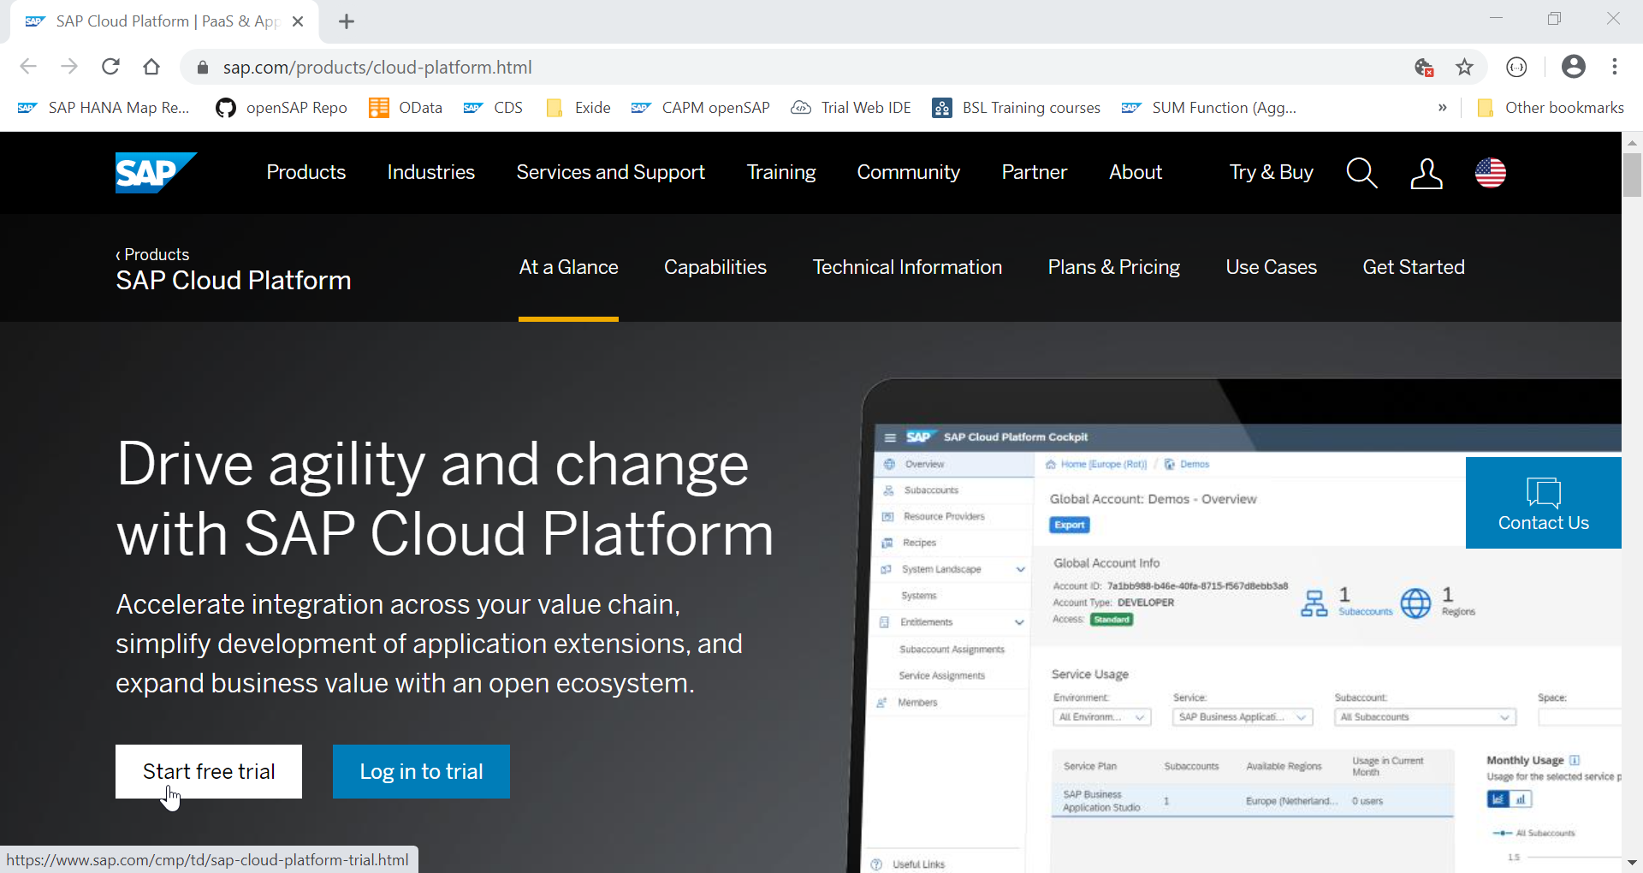
CREATING A FREE TRIAL ACCOUNT

Slide 32
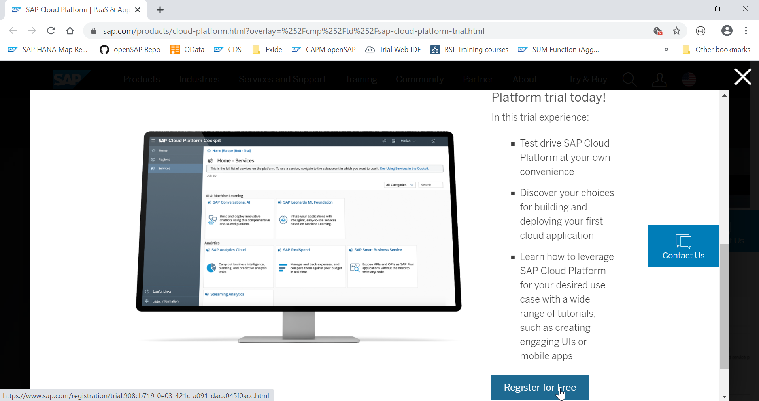

Slide 33
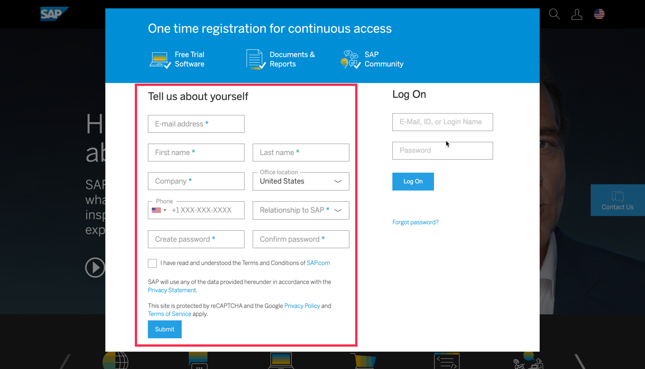
If you don’t have an account already, fill in the details on left-hand side of the dialog and click submit

Slide 34
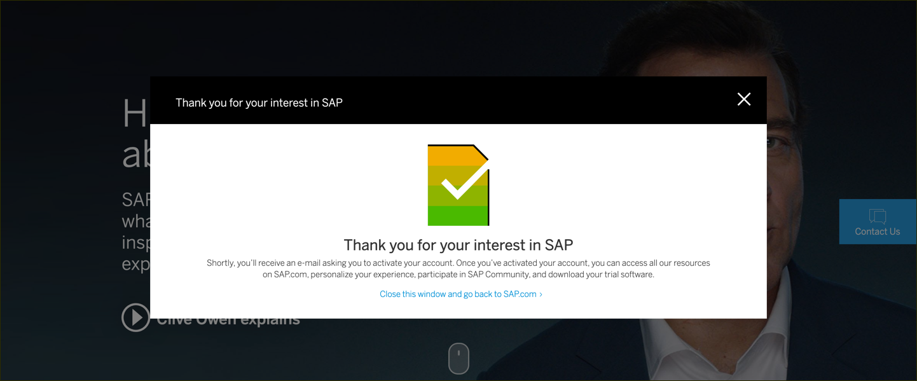
You will get an email saying activation link has been sent to you.

Slide 35
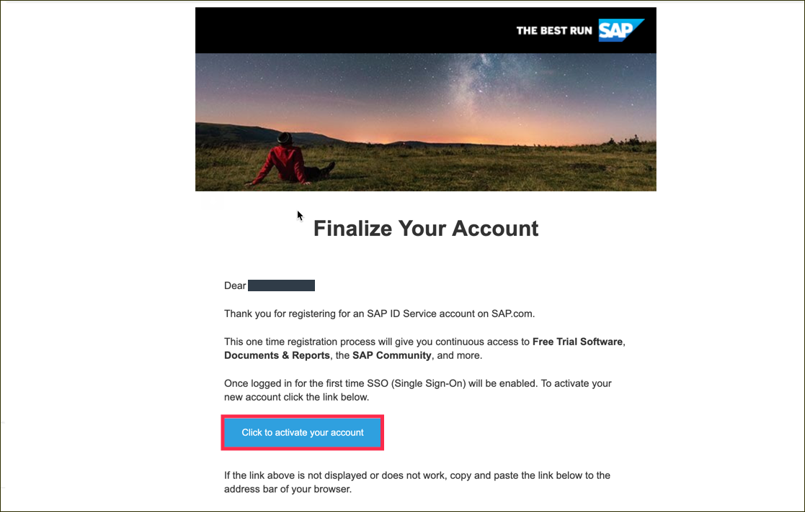
Click to activate your account

Slide 36
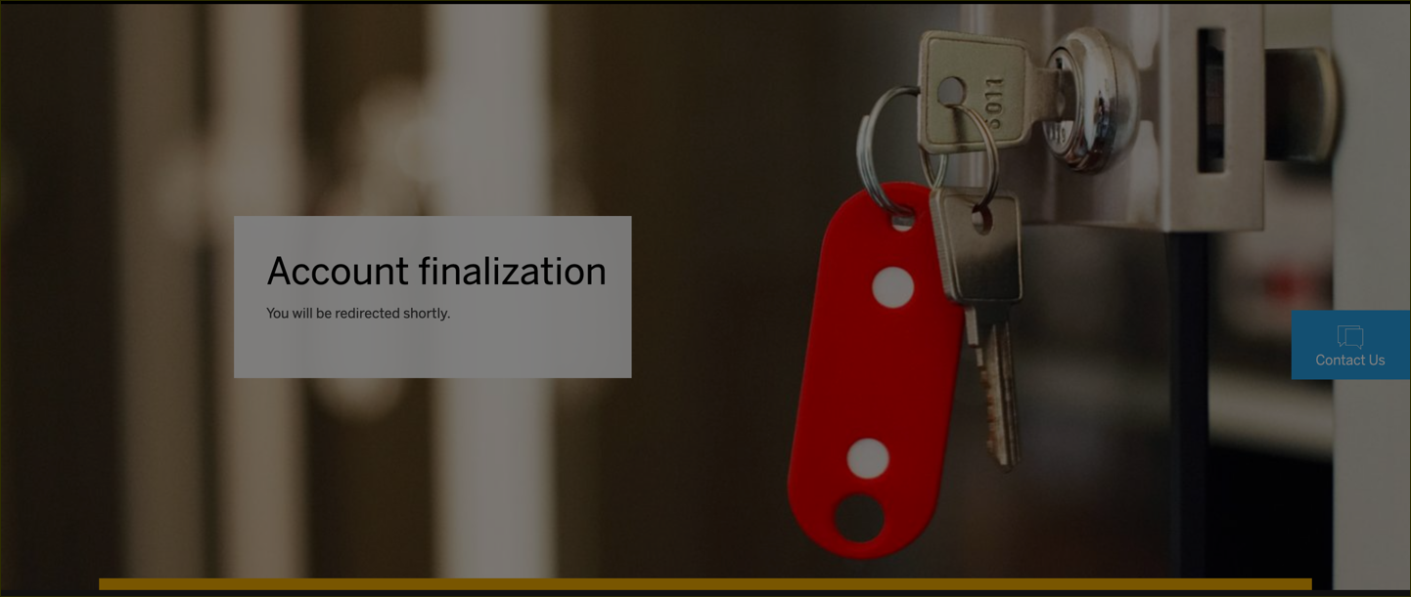
After activating your account you will see the following screen.

Slide 37
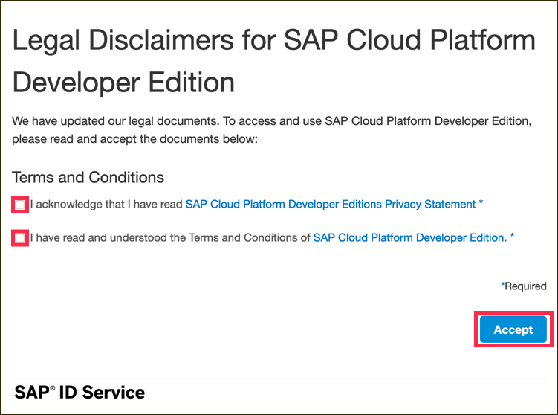
Go to SAP Cloud Platform page and click on Log on

Slide 38
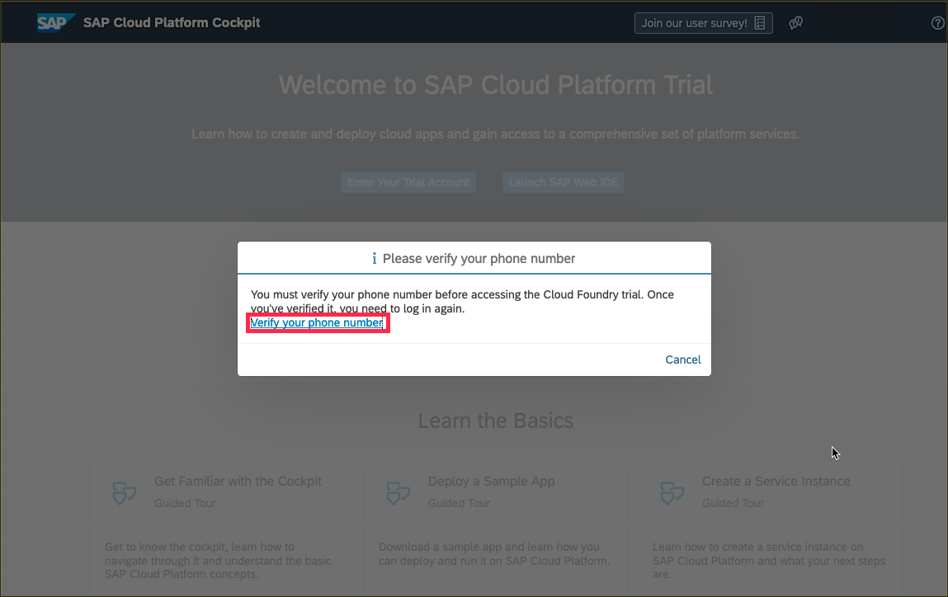
Verify your account with a phone number.

Slide 39
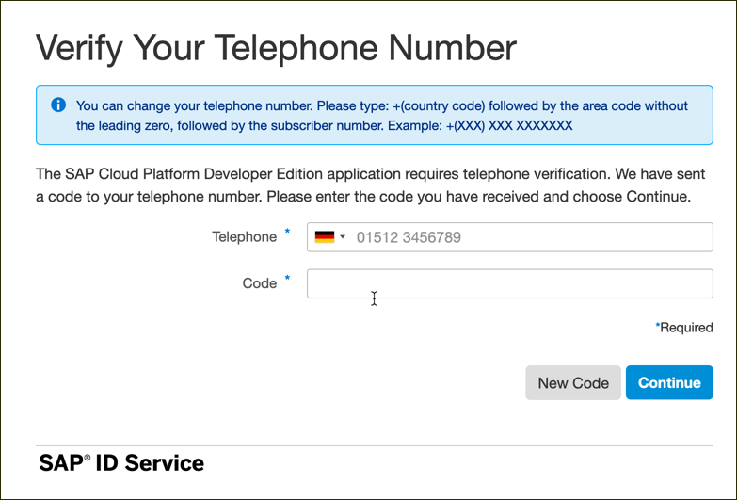
Enter your phone number and click New Code to retrieve a code

Slide 40
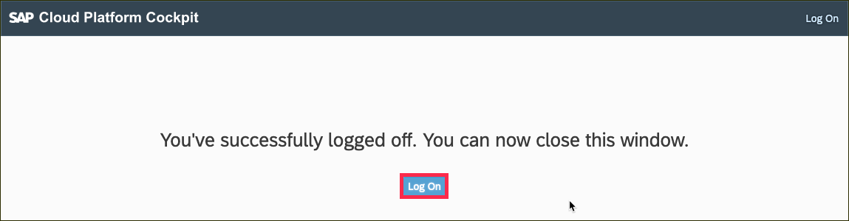
Click on Log on to log on to your verified account.

Slide 41
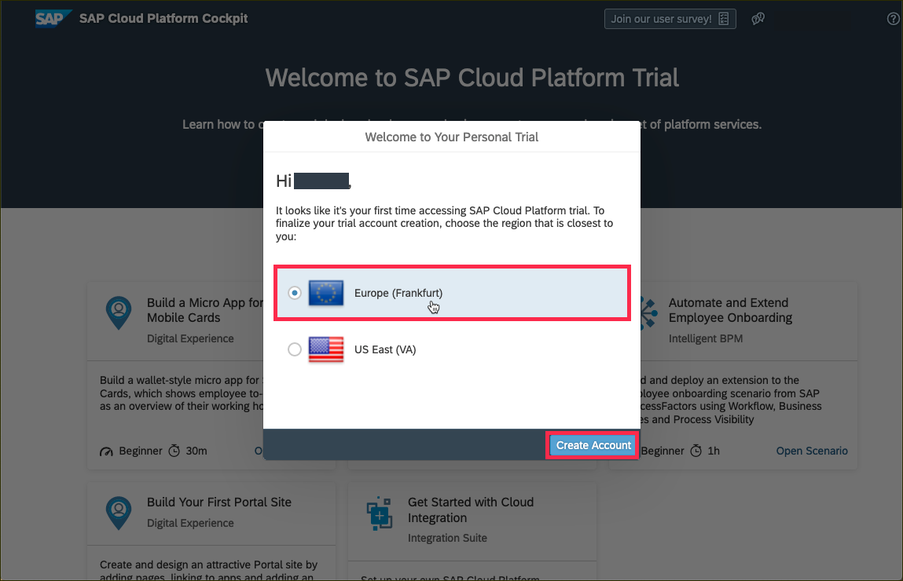
Create a subaccount which lives in a geographic region. Choose one of regions from this list.

Slide 42
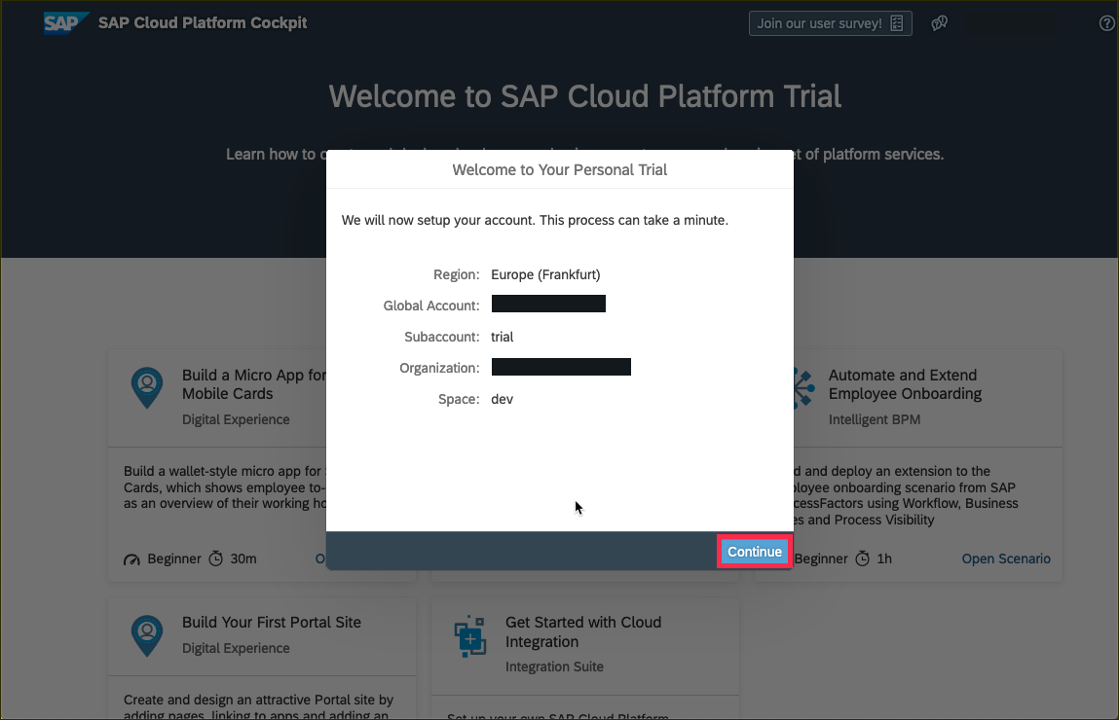
You will then see a dialog box while the account is set up. When complete, the dialog box will look like this. Click Continue to close to popup.

Slide 43
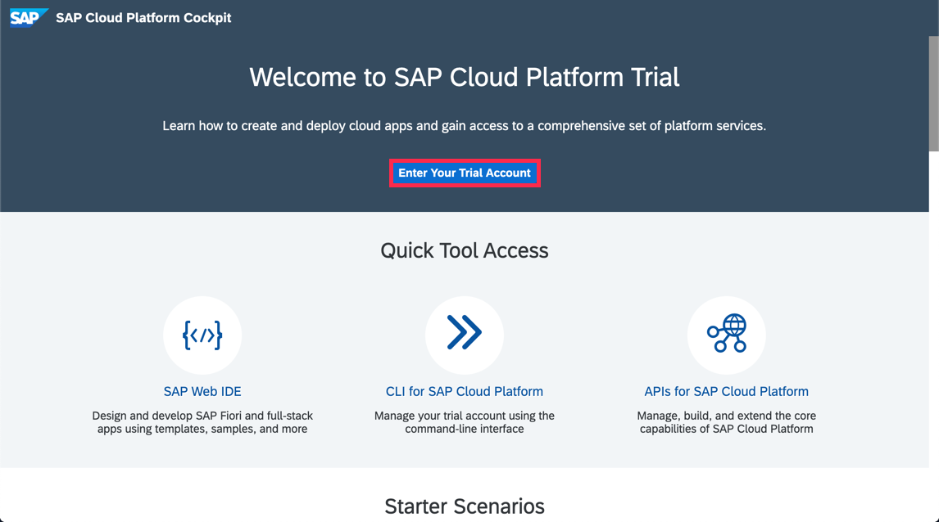
Click on Enter Your Trial Account to see your global account.

Slide 44
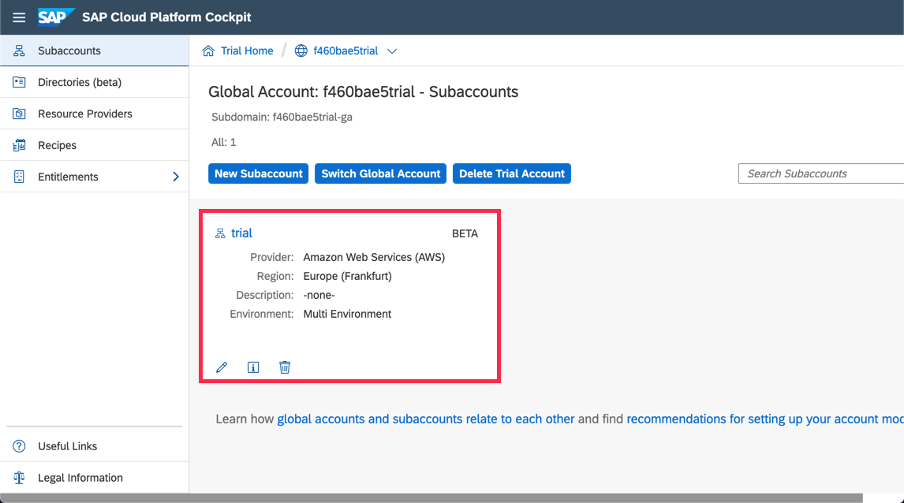
The global trial account contains one subaccount and space. Navigate to subaccount by clicking on the tile named trial (this name may vary if you created the subaccount manually).

Slide 45
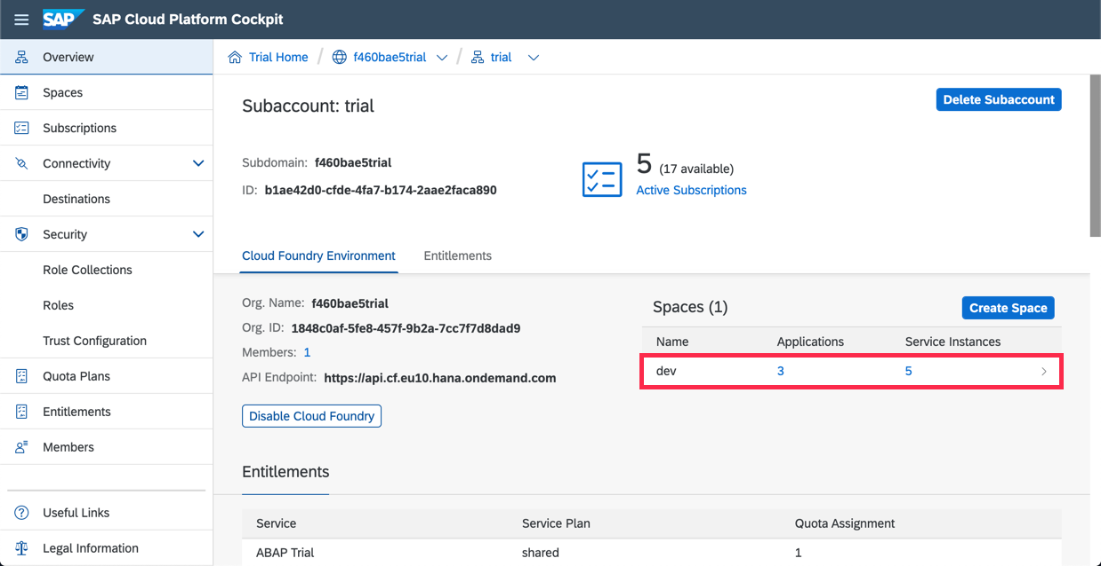
To get to the space, in which your applications and services live, click on the dev space.

Slide 46
Introducing SAP Web IDE Full-Stack
SAP Web IDE is a web – based integrated development tool that simplifies end-to-end development of business applications.
tooling, prototyping, developing and deploying the application and make it available to end users.
Build SAP Fiori, mobile and Internet of Things (IoT) applications, even supports scenarios such as SAP S/4 HANA extensions.

Slide 47
Features and Benefits
Zero installation and maintenance
High productivity tools.
Java and Node.js Debuggers.
Business Application Development.
Visual UI editors.
Code Authoring Toolset.
SCM.

Slide 48
Accessing SAP Web IDE
Go to SAP Cloud Platform Cockpit Home page
Click on SAP Web IDE
Bookmark the URL
Configure API Endpoint in Cloud Foundry settings in SAP Web IDE.

Slide 49
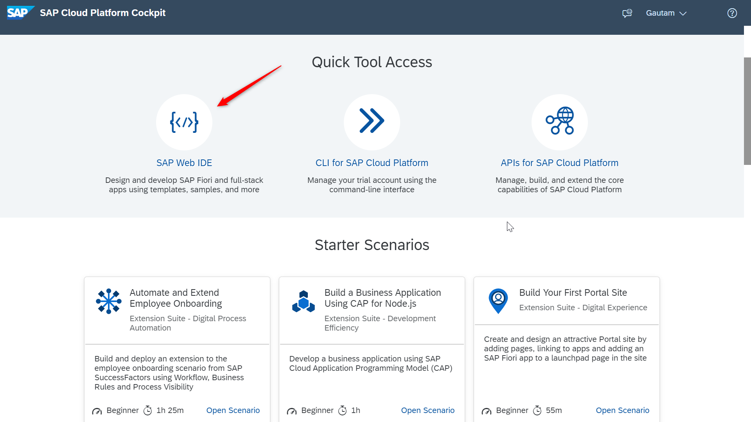
Go to SAP Cloud Platform Cockpit home page.

Slide 50
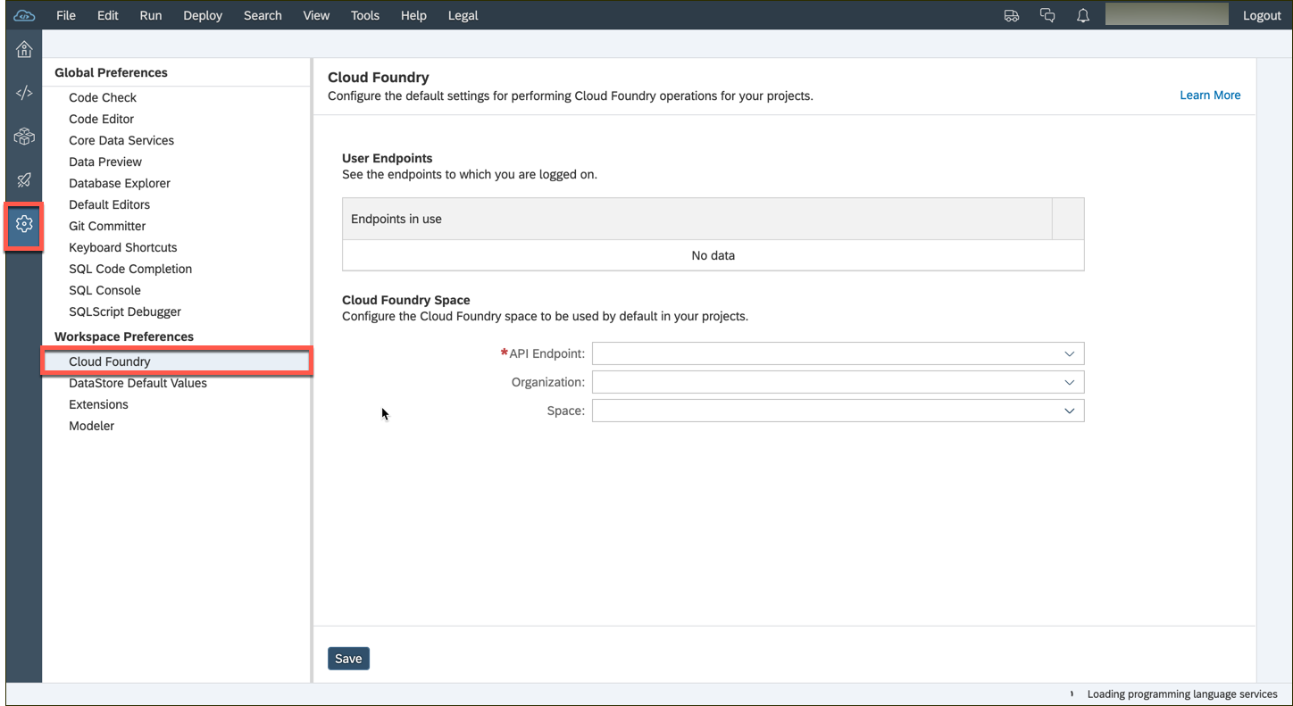
Go to Preferences > Workspace Preferences > Cloud Foundry

Slide 51
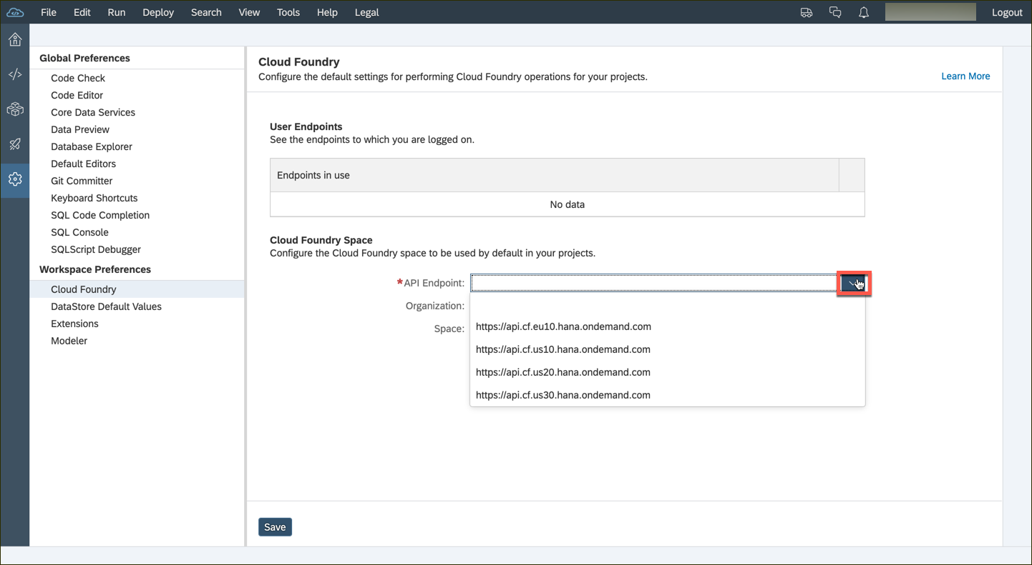
Configure the API Endpoint depending on the data center of your subaccount.

Slide 52
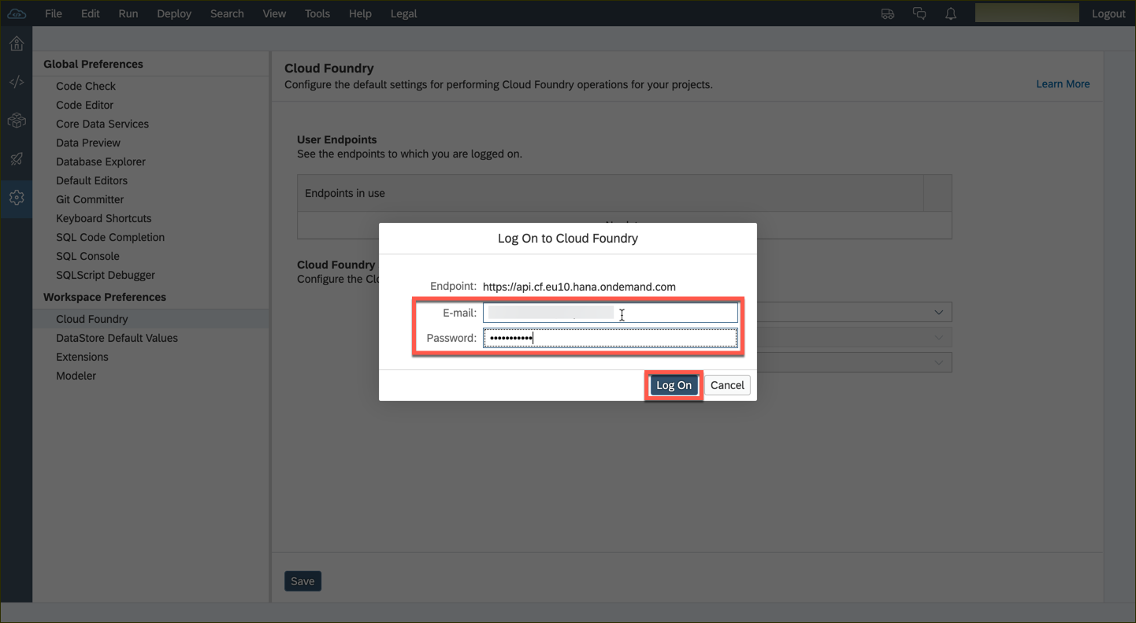
You might be prompted for your Cloud Foundry credentials. Enter the credentials you used for SAP Cloud Platform Cockpit.

Slide 53
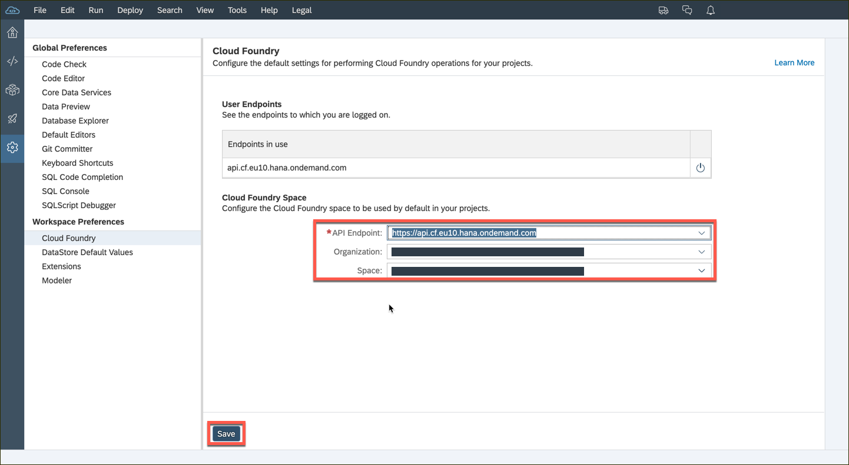
If there is a subaccount in the selected data center then the organization and space fields will be populated by default. You can change these values via the dropdown list. Hit the Save button thereafter.

Slide 54
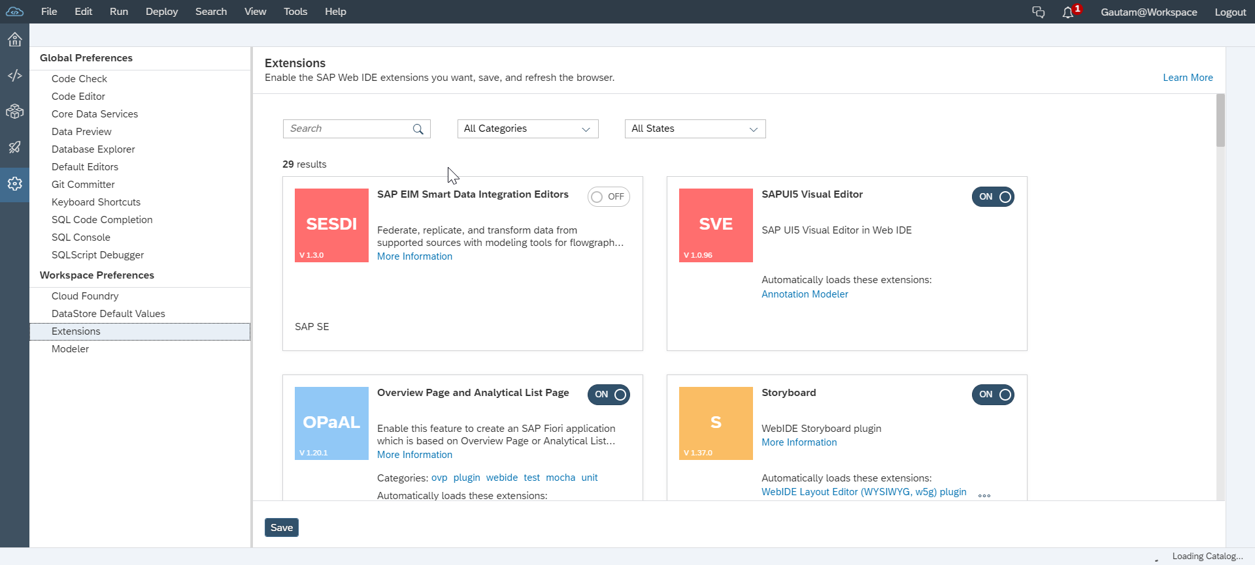
Extensions
To extend the existing functionality.
Tools > Preferences > Workspace Preferences > Extensions
For example,
SAP HANA Database Development Tools extension needs to enabled to create design time database artifacts, such as data models, views or procedures.

Slide 55
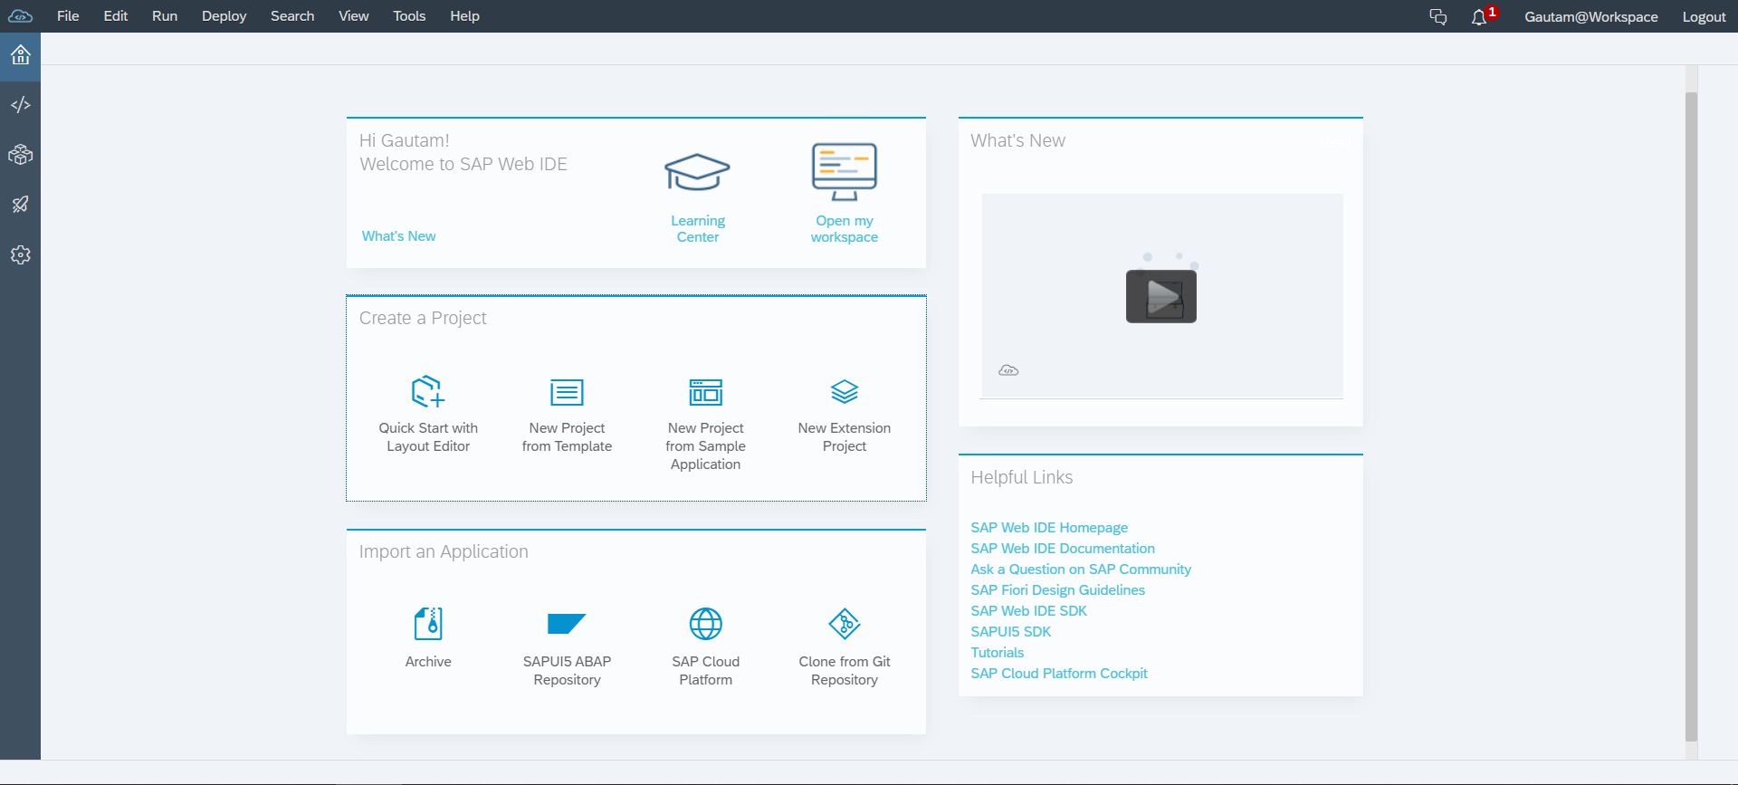
Home Screen of SAP Web IDE
Perspectives:
Home(Welcome)
Development
Database Explorer
Storyboard
Preferences
Quick and easy access to most common creation actions.
Link to external resources and tools.

Slide 56
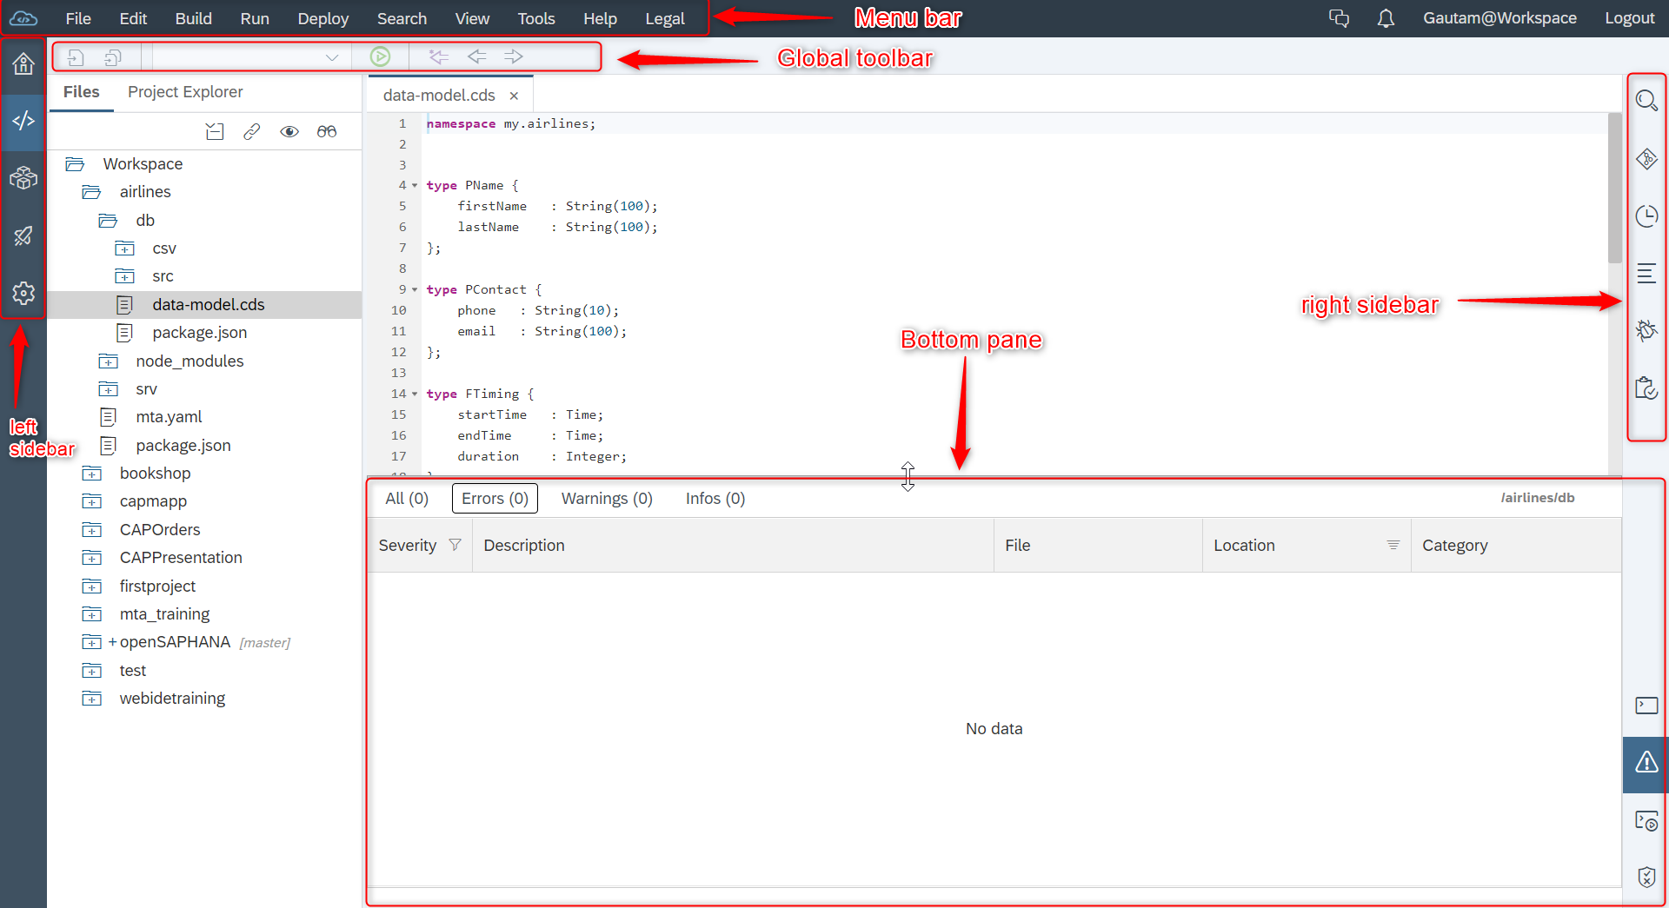
Navigating SAP Web IDE

Slide 57
SAP Business Application Studio
Tailored for efficient development of business applications for the Intelligent Enterprise.
Next generation of SAP Web IDE, the current development environment.
It is available on SAP’s Multi-Cloud Environment (Cloud Foundry) for productive use.
Provides solution based on Dev-Spaces.

